Slide 1
College Event Website
By: Group 15
Members: Matthew Balwant & dave Nandlall

Slide 2
Overview
The college event website allows students to view events.
Students can view events at their university location.
Students can also view events at other university locations.
Students can request to create an RSO group or request to follow another RSO group.
They are also allowed to view RSO events based on the RSO group they are following.

Slide 3
Levels of Access
Super Admin
Administrator
Student
One superadmin per university.
Creates/Owns a university profile (ex. UCF)
Designates admins for that university (≥ 5)
Approves events create by an admin.
Multiple administrators per university ( ≥ 5)
Creates events
Owns multiple RSO’s
View/Join Events
Create/Join RSO
Comment/Rate Events

Slide 4
Front End Development
HTML5
CSS3
JavaScript
Bootstrap
JQuery

Slide 5
Backend Development
Languages : Java
Database : MariaDB
Everything Else : Java Libraries

Slide 6
Java Libraries
Jetty - a Java HTTP Web server and Java Servlet container.
JDBI - an SQL convenience library for Java.
HikariCP - is a “zero-overhead” production-quality connection pool.
Google Guava - open-source set of common libraries for Java.
Google GSON - an open source Java library to serialize and deserialize Java objects to (and from) JSON.
JSoup - is a Java library for working with real-world HTML. It provides a very convenient API for extracting and manipulating data, using the best of DOM, CSS, and jQuery-like methods.

Slide 7
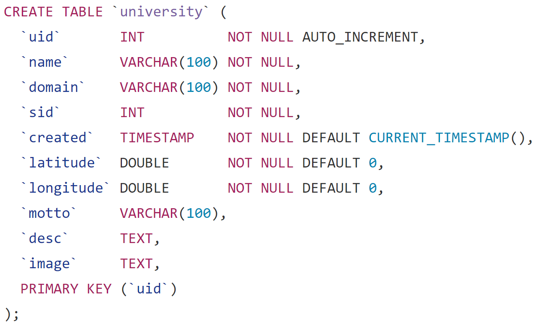
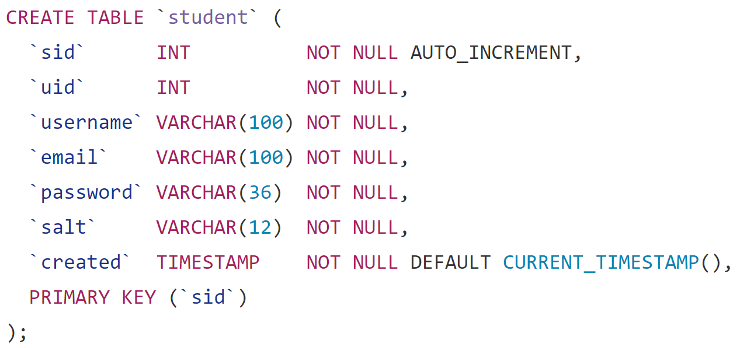
Database Structure

Slide 8
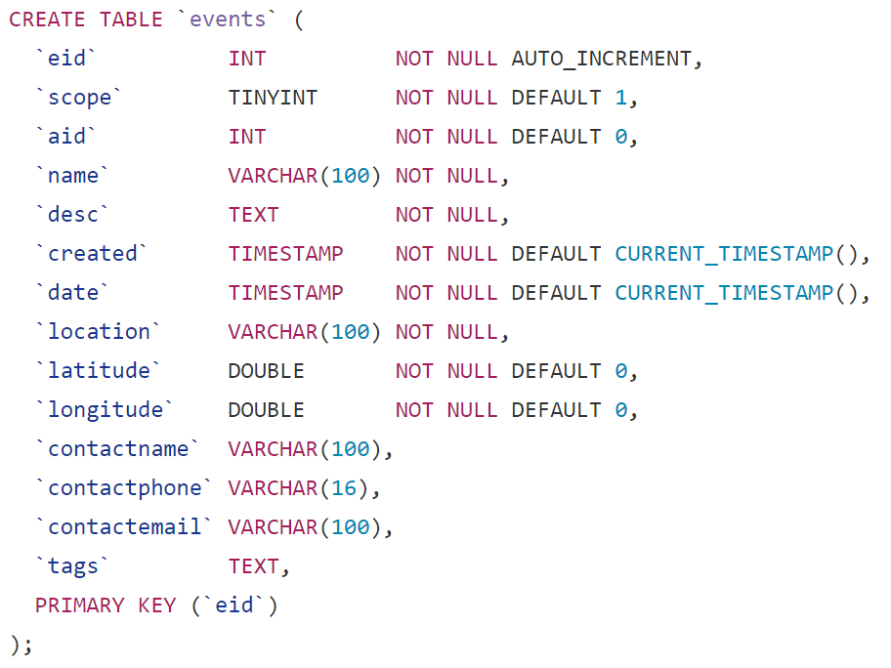
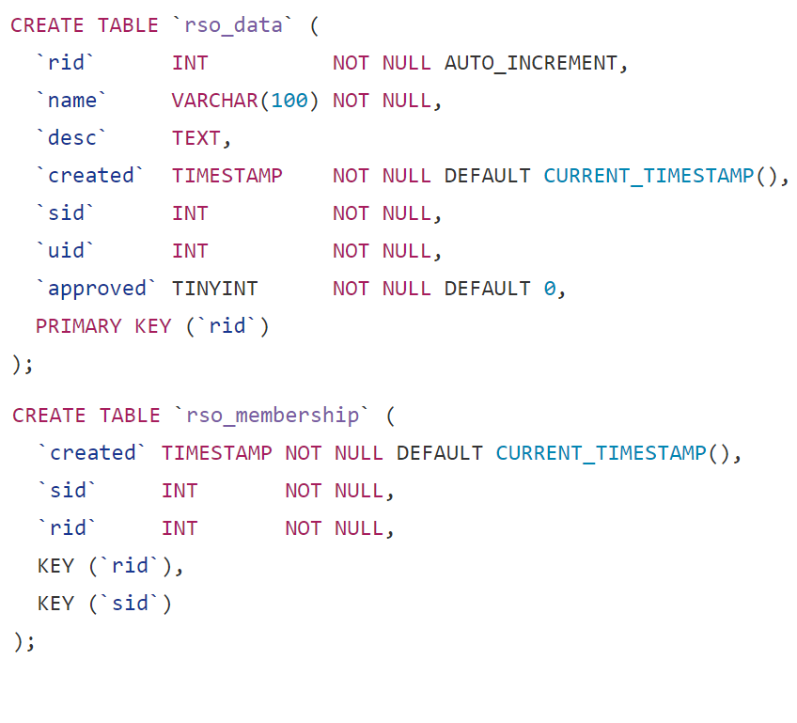
Database Structure - Continued

Slide 9
ER Model

Slide 10
Relational Model

Slide 11
Improvements

